Slide 1
IBM COMPANY
IBM HR Employee Attrition

Slide 2

Objective
The objective of the project is to use skills programming to analyse a IBM Company to perform exploratory data analysis by answering the question in the upcoming slides.
The objective of the project is to use skills programming to analyse a IBM Company to perform exploratory data analysis by answering the question in the upcoming slides.

Slide 3
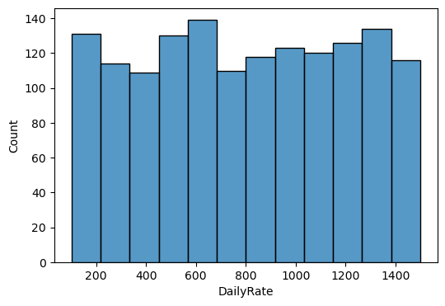
Task 1
What is the count of employees daily rating?

Slide 4
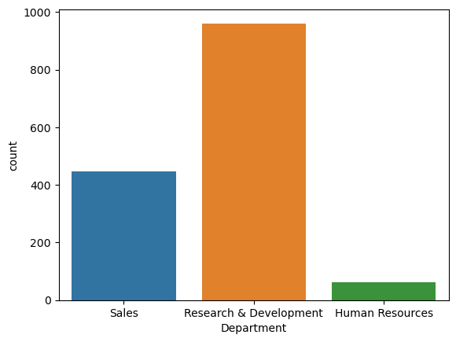
Task 2
Which department have the highest count of employees .

Slide 5
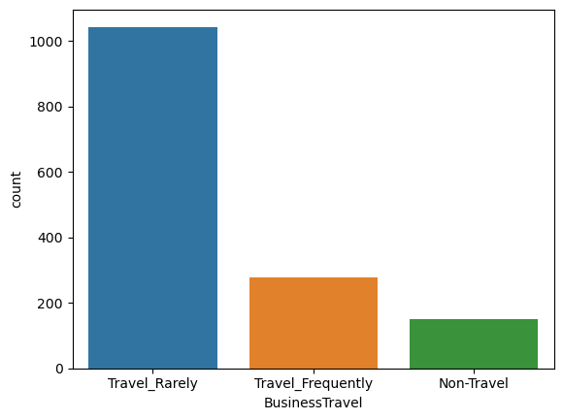
Task 3
Which Business Travel have the highest count of employees

Slide 6
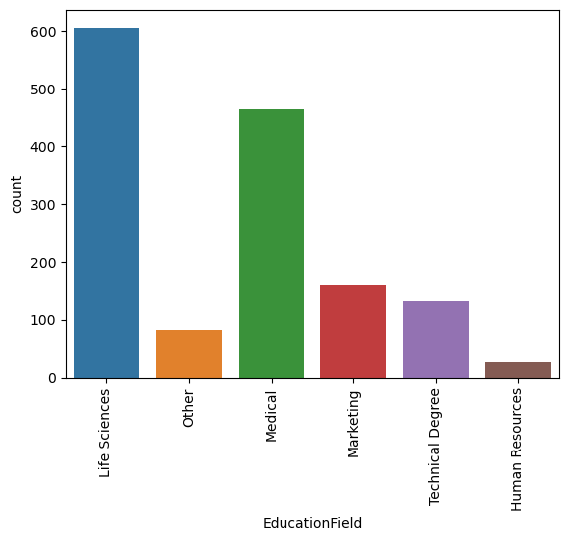
Task 4
Which Education Field have the highest count employees .

Slide 7
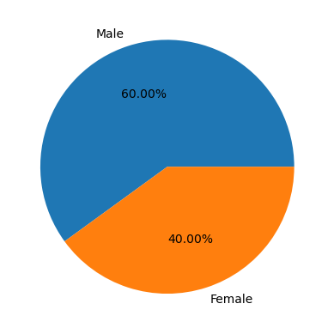
Task 5
Which gender have the highest percentage.

Slide 8
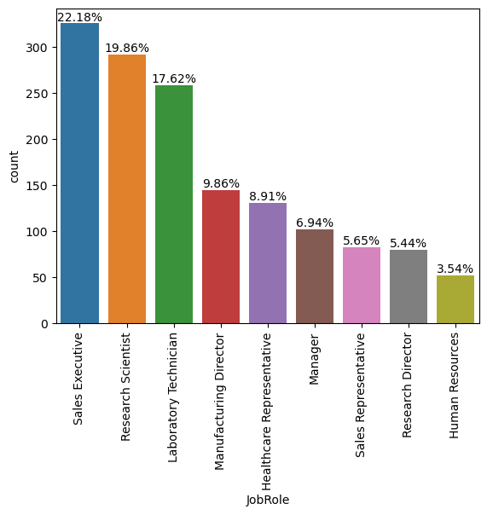
Task 6
Which Job Role have the highest percentage of employees .

Slide 9
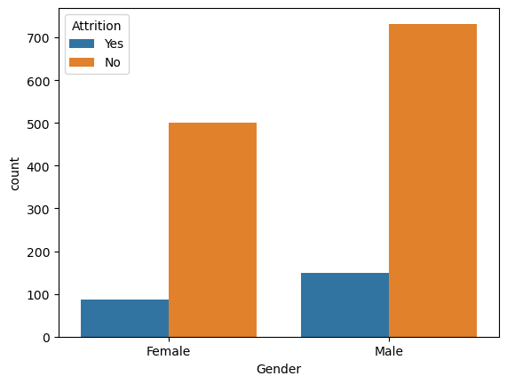
Task 7
What is the Gender wise Attrition ?

Slide 10
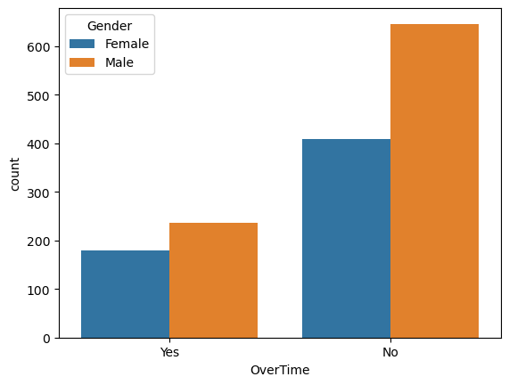
Task 8
What is Gender wise overtime ?

Slide 11
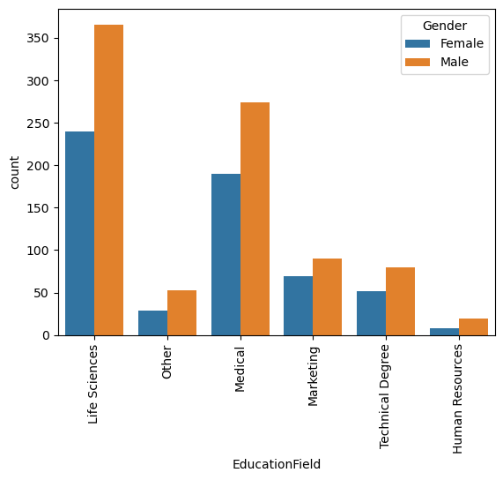
Task 9
Which Education Field have the highest count of employees as per gender .

Slide 12
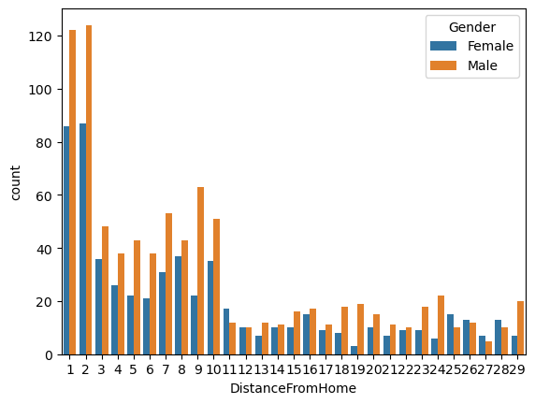
Task 10
Which gender have the highest Distance From Home .

Slide 13
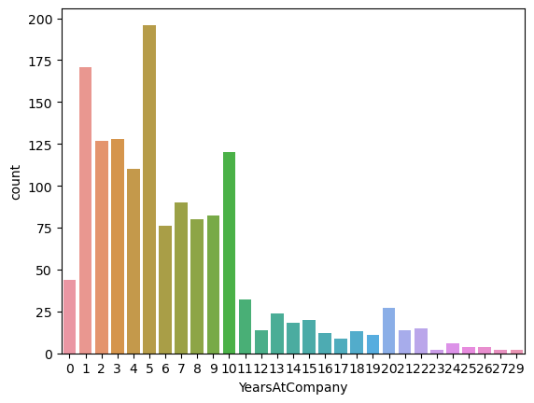
Task 11
Less than 30 years at the company .
Which year have the highest count of employees .

Slide 14
Conclusion
Research and Development have the highest count employees.
Most of the employees travel rarely .
Life Sciences have the highest count of employees.
There are 60 % of the male employees .
There are 22.18 % of employees are in Sales Executive job role .
Male have the highest number of yes and no .
There is very less number of employees who are doing overtime .
Life Sciences have the highest count of employees as per gender.
2 have the highest count of employees as per gender .
5 years have the highest count of employees.

Slide 15


